Slide 1



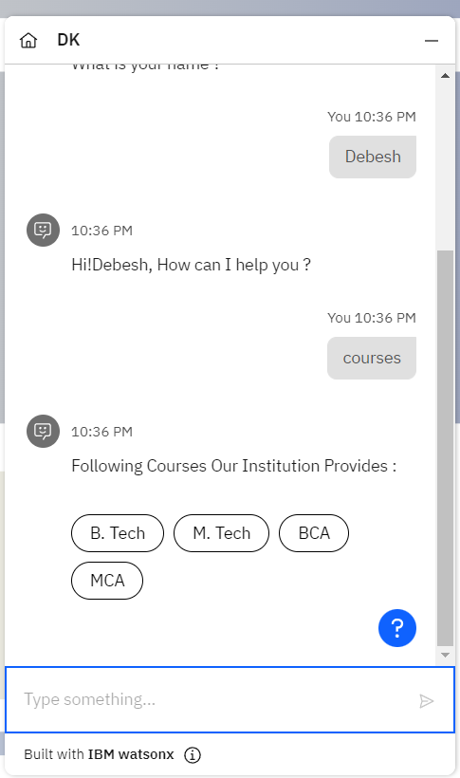
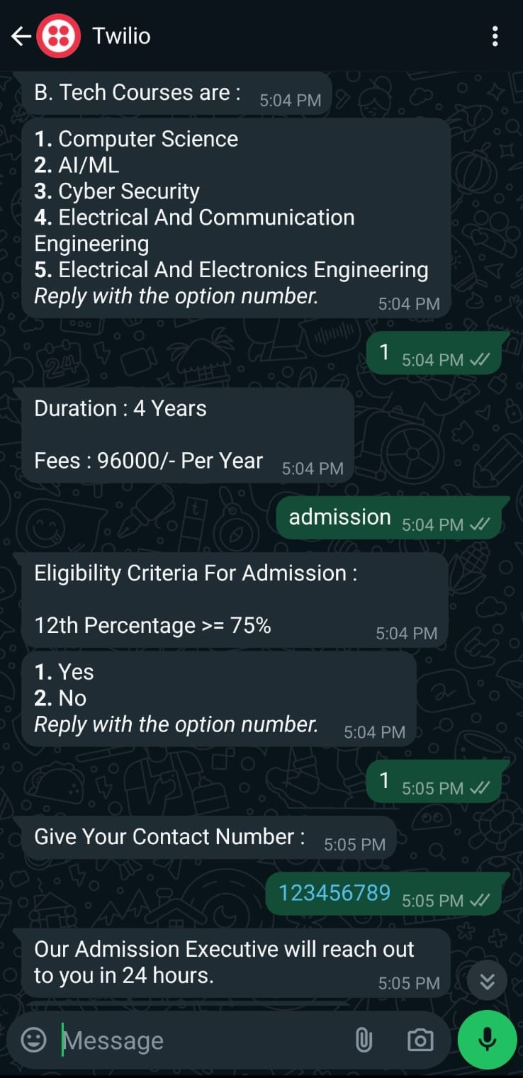
Chatbot Using WatsonX
Project Short Summary
I developed a college admission chatbot using WatsonX IBM AI, designed to streamline the application process for prospective students. The chatbot provides detailed information on courses, fees, and duration, and collects student names and phone numbers for follow-up. This innovation enhances user experience, accessibility, and ensures accurate and timely responses to student inquiries.
Program Feedback
Excellent hands-on experience with cutting-edge tech and a supportive team. It significantly boosted my skills.
Debesh Kumar Patel
patel.debeshkumar@gmail.co
Sambalpur University Institute Of Information Technology, Burla
#skillsbuild

